Slide 1
Turning Your Brand Inside Out
JB Communications, LLC
jbonano@jbcommunications.net
504-512-0147

Slide 3
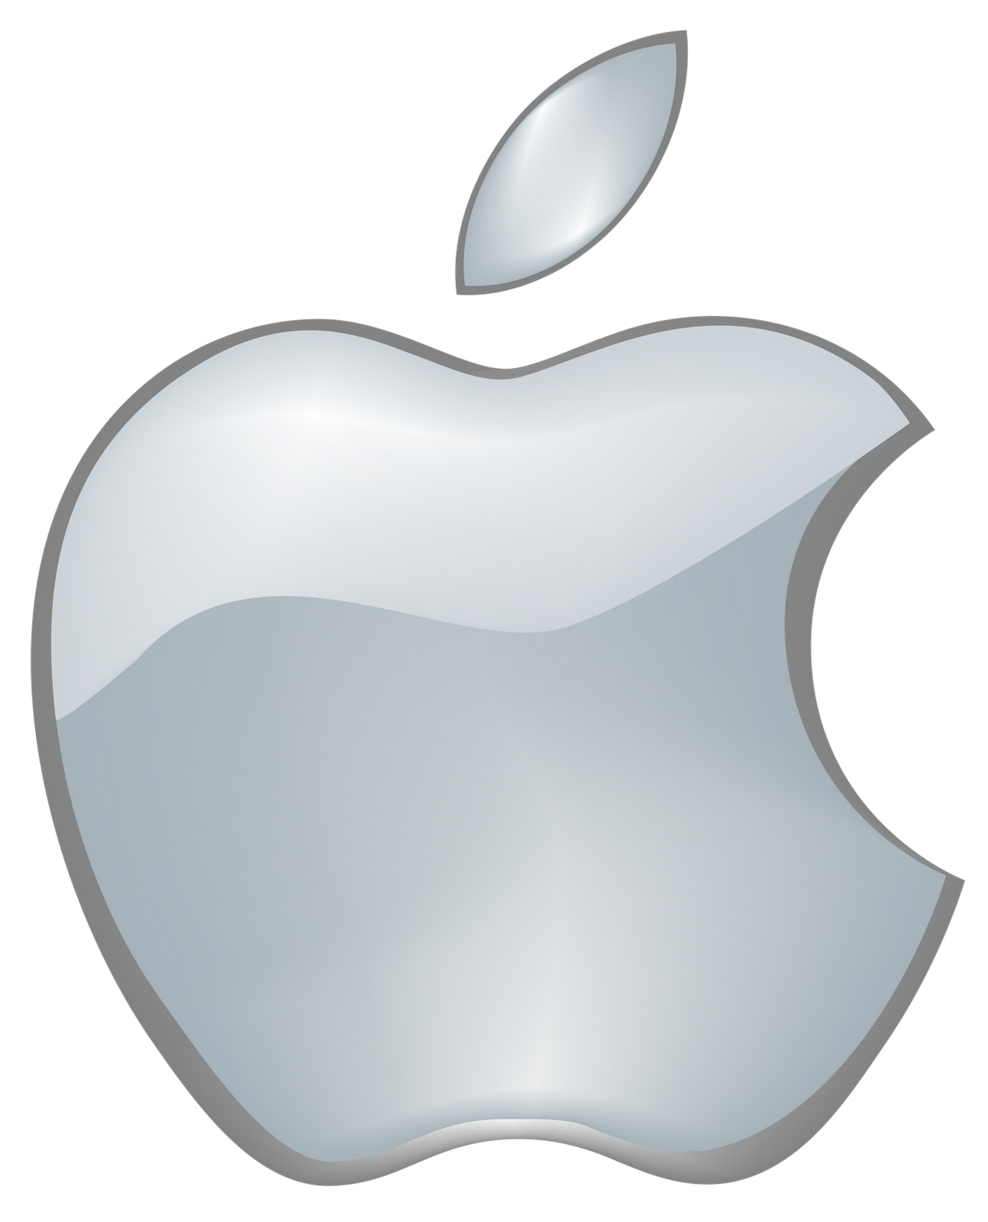

Slide 20
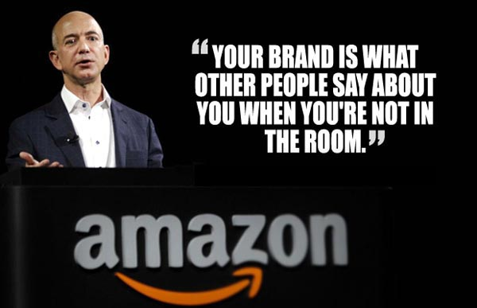
Jeff Bezos, Founder of Amazon.com

Slide 21
Your Brand is Your DNA!

Slide 22
ECLIPSE VIEWING - 1979

Slide 23
ECLIPSE VIEWING - 2017

Slide 25
Who Should Define Your Brand?
No one knows your brand better than you, the owner or the key executive.
The strength of your brand relies on your passion for the business.

Slide 26
Key Departments Responsible for Branding
Sales
Human
Resources
Marketing

Slide 27
Define Your Brand Identity
Self Discovery
Define Your Mission / Your Purpose
Determine Your Target Audience
Public Perception
Know Your Competition
Identify Your Brand’s Features & Benefits

Slide 28
Visual Branding
Logo
Tagline
Branding Rules
Social Media Images
Photography

Slide 29
Logo Elements
Design
Font
PMS Color
Vector / Sizable (.EPS, .AI)
Primary Logo
Secondary Logo
Abbreviated Logo
Reversible Logo
One Color Logo

Slide 30
Internal Branding
Employee Training
Onboarding / Orientation
Culture
Product
Customer Service
Sales
Etiquette
Service Standards
Uniforms / Dress Requirements
Company Policies

Slide 31
Employee Training Resources
LOUISIANA COMPANY TRAINING GRANTS
Incumbent Workers Training Program (IWTP)
Small Business Employee Training (SBET)
50 or Fewer Employees

Slide 32
External Branding
Signage
Website
Social Media / Blogs / Reviews
Search Engines
Advertising
Packaging / Presentations
Public Relations*
Standardize Boiler Plate
Press Release Template

Slide 33
Dual Controls – External Marketing
Website
Domain Names | URL (Company or Principal – Registrant)
Multiple Domain Names
Google | Bing | Social Media | Etc.
Admin Logins
Advertising | Production
Ownership Rights
Packaging | Presentations

Slide 34
Blog Statistics
Marketers who prioritize blogging efforts are 13x more likely to see positive ROI (Source: HubSpot)
On average, companies with blogs produce 67% more leads per month than those without (Source: DemandMetric)
60% of consumers feel engaged/positive with a brand or company after reading custom content on their blog
Blogging is responsible for 434% more indexed pages and 97% more indexed links (Source: DemandMetric)
47% of buyers viewed 3-5 pieces of content before engaging with a sales rep. (Demand Gen Report, 2016)
94% of people who share posts do so because they think it might be helpful to others. (source)
Companies who blog receive 97% more links to their website. (source)

Slide 35
Public Relations Highlights
Be an Advocate for Your Company
Choose a Spokesman
Send Out Releases on Milestones, New Hires, Promotions, New Products / Services, Awards, Etc.Link Your Releases to Your Website
Boilerplate (About Us)
Under 100 words
What your company does and for whom
Strengths without overexaggerating
Avoid jargon and corporate-speak
Tagline
Keywords
Competitive Advantage
Link to website
Stock symbols (if applicable)

Slide 36
Apple revolutionized personal technology with the introduction of the Macintosh in 1984. Today, Apple leads the world in innovation with iPhone, iPad, Mac, Apple Watch and Apple TV. Apple’s four software platforms — iOS, macOS, watchOS and tvOS — provide seamless experiences across all Apple devices and empower people with breakthrough services including the App Store, Apple Music, Apple Pay and iCloud. Apple’s more than 100,000 employees are dedicated to making the best products on earth, and to leaving the world better than we found it. NASDAQ: AAPL. Apple.com
Boilerplate Example

Slide 37
Protect Your Brand – Follow Up
Secret / Mystery Shopping
Follow / Respond to Reviews
Customer Feedback
Employee Feedback
Testimonials

