Slide 1
Greater New Orleans Executive Association
November 19, 2024
Notes:
Intro self
Note colleagues with me

Slide 2
ABOUT US
Jefferson Ready Start Network (JRSN) is a coalition of thought partners committed to creating and implementing a bold local vision for early care and education – driven by our community’s need to improve opportunities and inspire change for children from birth to age five.
We bring together coalitions of individuals to increase access to quality early childhood experiences in Jefferson Parish. Guided by local data and context, we collaborate to develop intentional plans, secure and weave together resources, and implement creative solutions.

Slide 3
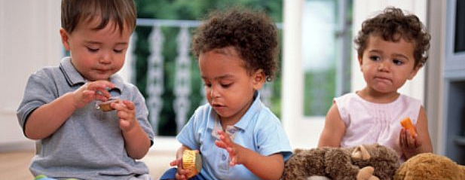
WHO’S INVOLVED
Jefferson Parish Schools serves as fiscal agent for JRSN for programmatic initiatives. The Jefferson Community Foundation serves as fiscal agent for fundraising and community nonprofit initiatives. The work of JRSN is directed by a coalition of Thought Partners (community leaders from multiple sectors) and supported by a Core Leadership Team (early childhood stakeholders).
Notes:
This coalition coordinates the work across – all publicly funded ece programs:
70 Child care centers
14 Early Head Start
9 Head Start
3 Parochial schools
52 JPS elementary schools – 164 PK classrooms

Slide 4
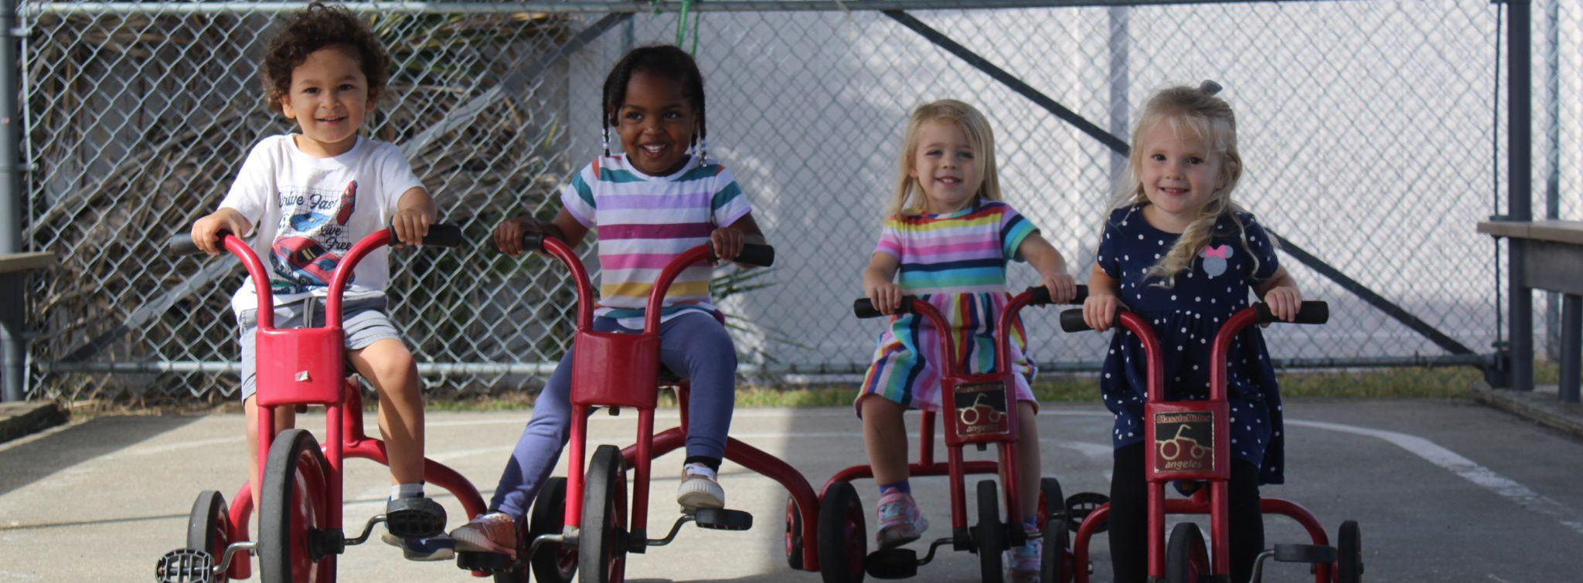
WHY EARLY CHILDHOOD MATTERS

Slide 5
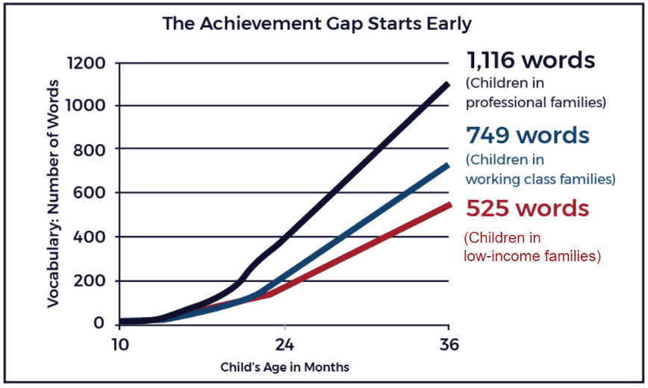
WHY EARLY CHILDHOOD MATTERS
Achievement gaps before kindergarten
Unfortunately, many children who do not participate in high-quality early childhood programs are not fully prepared to begin school.
Those most likely to begin kindergarten at an academic disadvantage are low-income and minority children.
Children from disadvantaged families have less than 50 percent of the vocabulary their more affluent peers do.

Slide 6
WHY EARLY CHILDHOOD MATTERS
The first five years are the most critical in the development of a child’s brain. From birth to age 3, children grow and learn at the most intense rate, forming more than a million neural connections every second; these are the years when children are learning how to learn. [1]
Notes:
Early childhood education is not only a smart investment with positive returns, but it is the right thing to do. Louisiana cannot afford the cost of inaction. The research is clear. Early learning opportunities for children from birth to age five have great impact on a child’s development and builds a strong foundation for learning and success later in life.

Slide 7
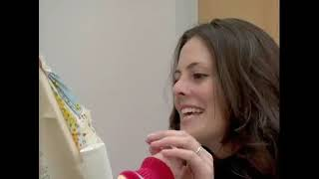
Brain Development
Notes:
https://www.youtube.com/watch?v=f1Jw0-LExyc

Slide 8
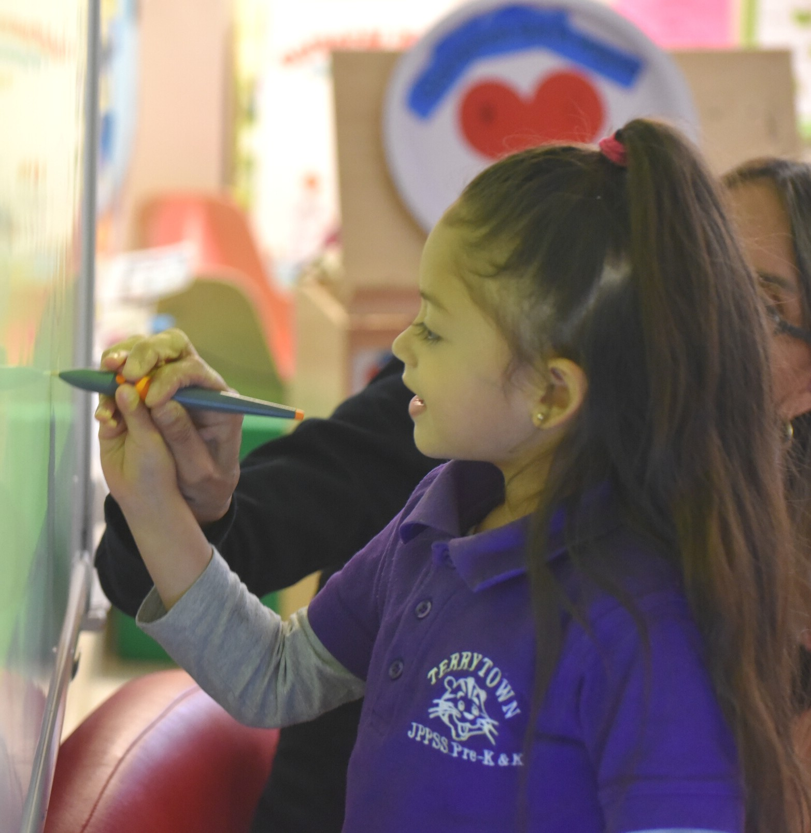
In Jefferson Parish,
less than 20%
of children are kindergarten ready.
AN EDUCATION ISSUE
High-quality early care and education helps ensure that our youngest children are ready for success in school and life!

Slide 9
A WORKFORCE DEVELOPMENT ISSUE
In Louisiana, 2 out of 3 children under age 5
have both parents or
their single parent in
the workforce.
Our working families rely on high-quality, affordable early care and education programs to enable them to leave the home for work or school.
Notes:
Covid highlighted the importance of early care and education for the workforce. Parents can’t get to work without quality, reliable care.

Slide 10
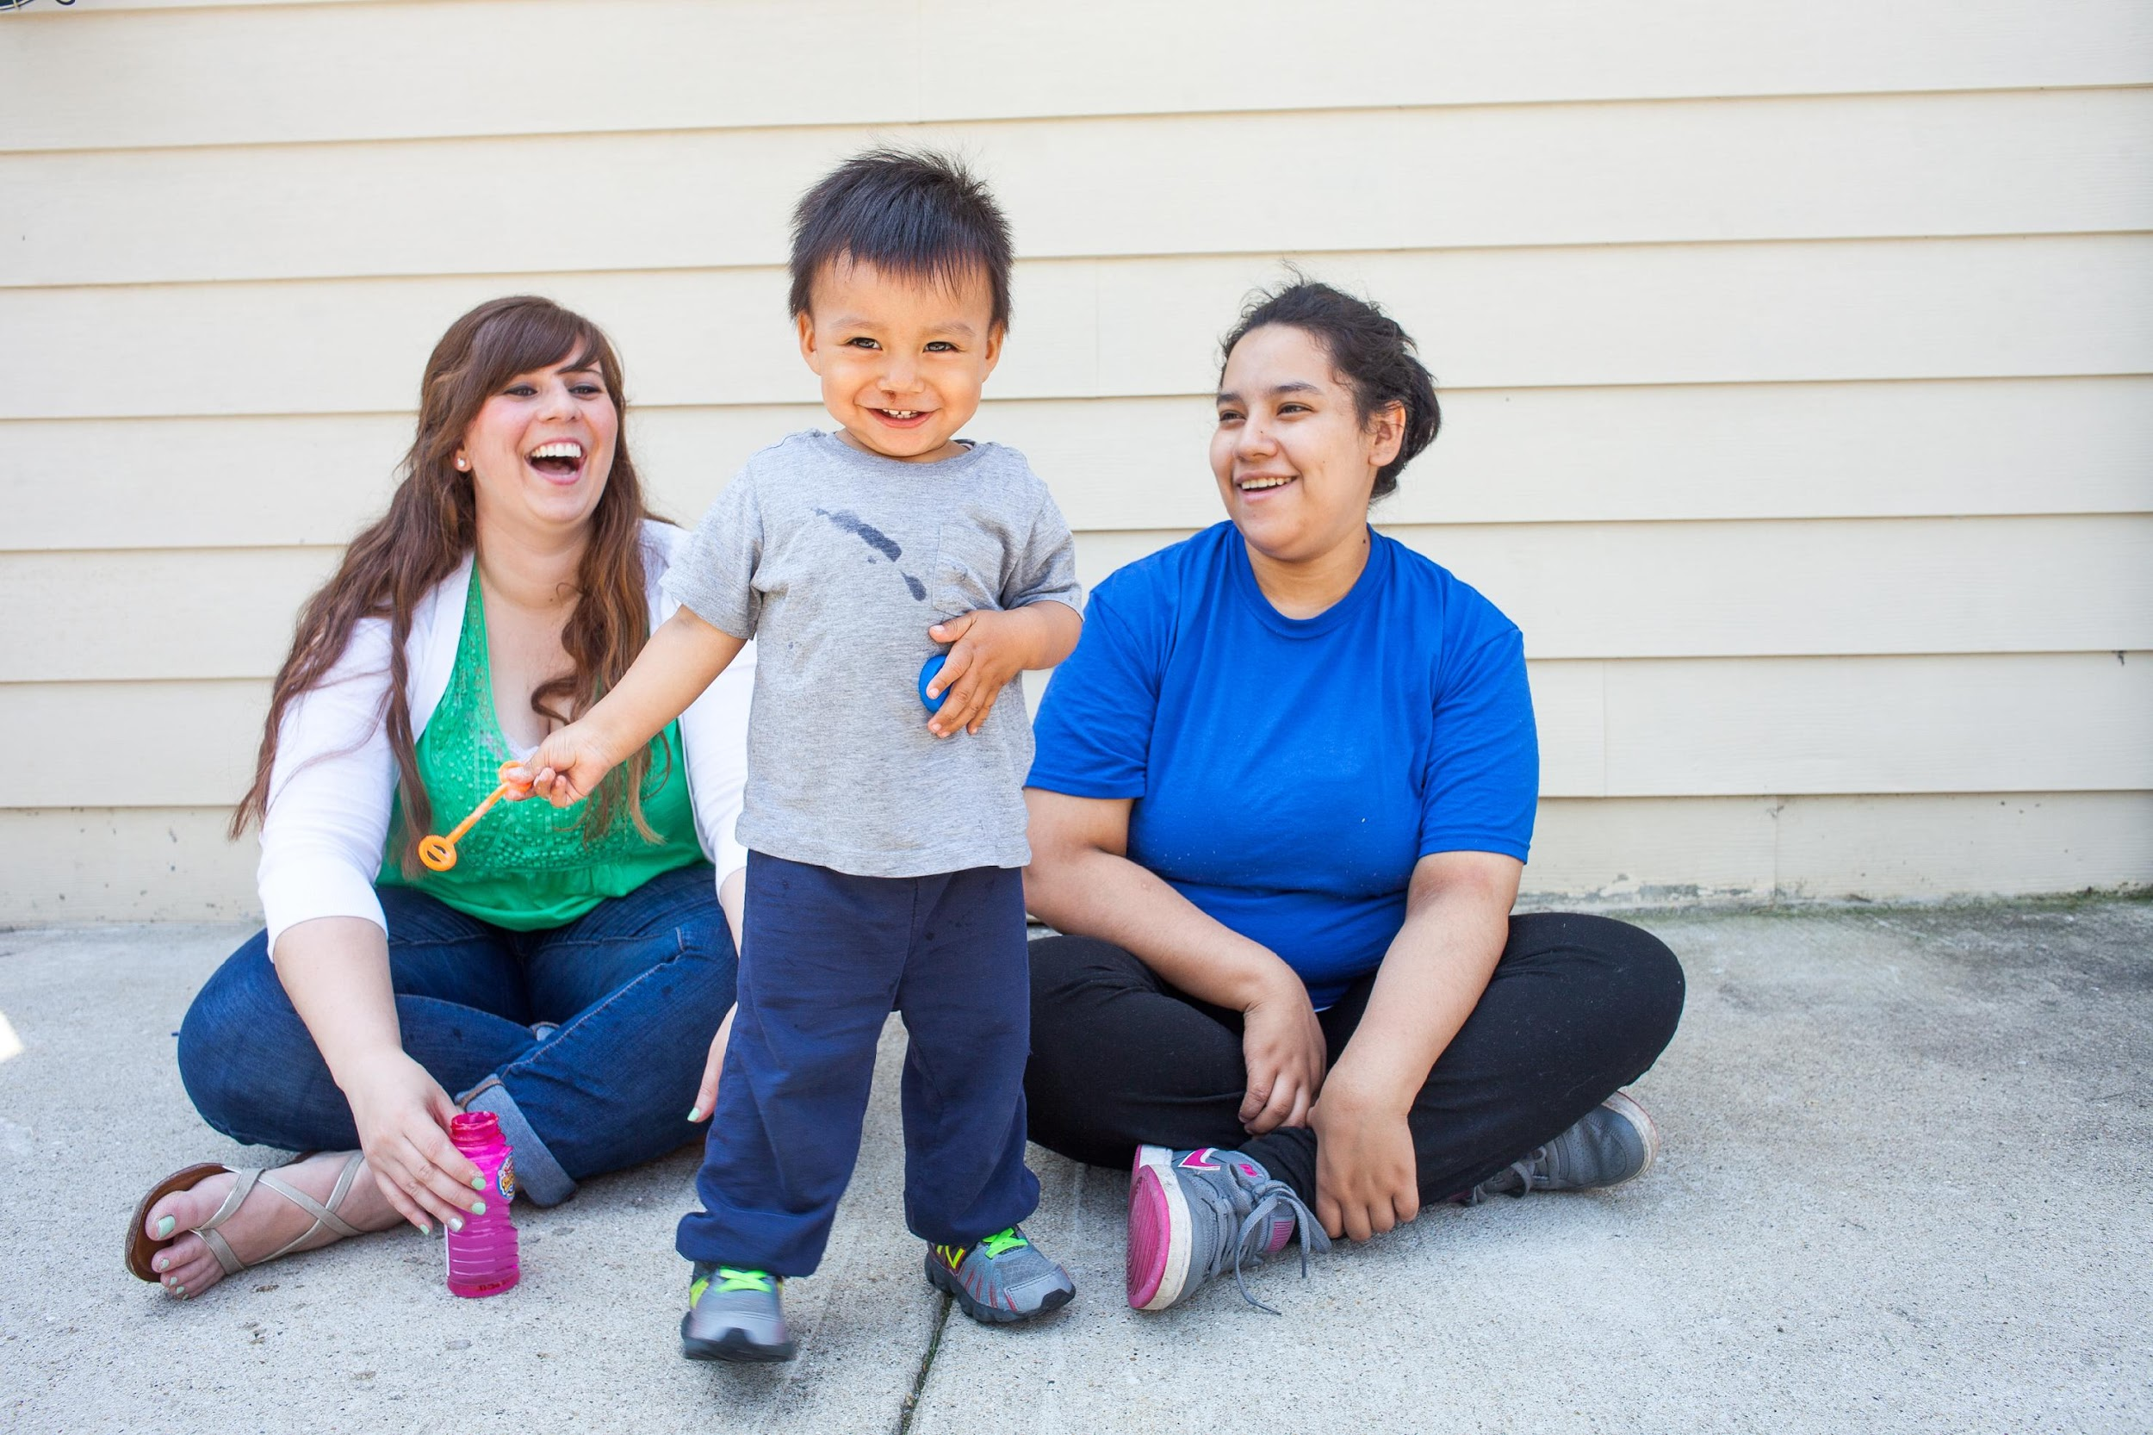
In the short term, employers incur a direct loss of $816 million a year due to lost workforce productivity (absenteeism and turnover).
AN ECONOMIC DEVELOPMENT ISSUE
While economists and policy makers have begun to understand the importance of child care, it was COVID-19 that shined a spotlight on the importance of child care for economic stability.
Notes:
Talk about calculator here????

Slide 11
IN JEFFERSON PARISH:
There are 28,000 children from birth to age 5,
of those children, 15,000 -20,000 are economically disadvantaged.
Approximately 5,000 of those children are served in publicly funded seats.
Notes:
So let’s set the stage for investment in Jefferson…..
Huge undertaking!!!

Slide 12
Jefferson Ready Start Network Initiatives
Lead Agency for Jefferson
Broker for Birth to Three-Year-Old Seats
Professional Development and Coaching

Slide 13
Expand Access by Increasing Seats
Jefferson Parish Council funding for seats
Louisiana Early Childhood Education Fund:
Matching funds for seats
United Way Grant for seats

Slide 14
Jefferson Ready Start Network Initiatives
Two-Generational Early Education
and Workforce Project
Jefferson Leadership Initiative
Community Educational Campaign

Slide 15
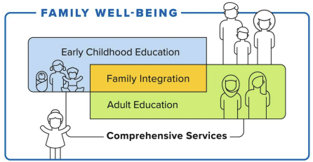
Two-Generation Workforce Initiative:
Early Learning Apprenticeships
JRSN piloted a two-generation strategy to support Spanish speaking parents to enter the early learning workspace. As apprentices, parents train to become EC teachers, while their own children are in high-quality classrooms down the hall.
Year One: Pilot Completed
6 apprentice teachers completed 960 hours of job-embedded training and professional development.
8 bilingual mentor teachers provided supports.
5 high-quality child care centers involved and certified as a WIOA workforce site.

Slide 16
Jefferson Institute for Early Childhood Leadership
Partnership of the Jefferson Community Foundation, Innovations in Education and Jefferson Ready Start Network
Funded by the Blue Cross Blue Shield Foundation of Louisiana
Institute grounded in leadership training and executive coaching
Focused on organizational culture
Designed to support new leaders to elevate the quality of care in their centers, and recruit, motivate, and retain exceptional teachers

Slide 17
Community Educational Campaign
Long-term purpose: Educate the public on the importance of ECE and the need for sustainable funding for maximum impact
Completed survey/poll of 500 residents regarding knowledge of the importance of early childhood and to identify outcomes important to them
Worked with demographer to identify areas in Jefferson to target campaign
Developed and launched ad and mailer

Slide 19
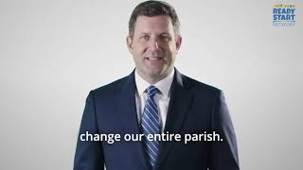
Notes:
https://www.youtube.com/watch?v=piJ22bJW7TY

Slide 20
What are the School Readiness Tax Credits?
In 2007, Louisiana passed Act 394 which provided a package of tax credits known as the School Readiness Tax Credit. There are five kinds:
Child Care Expense Tax Credit: allows tax payers with qualified dependent under age 6 attending a program (2 star or higher) to claim tax credit
Child Care Provider Tax Credit: allows providers to claim credit for providing care to foster children and CCAP children
Director and Staff Tax Credit: allows staff and directors to claim refundable tax credit if at a facility that participates in QRS and are enrolled in the Pathways Career Development System
Tax Credit for Business-Supported Child Care: Businesses who support child care can receive credit for a percentage of eligible expenses (e.g. repair or renovation, employee child care, etc.)
Tax Credit for Donation to Resource and Referral Agencies:
Businesses can receive tax credits for donations made to CCR&R.
Notes:
MONIQUE:
Previous Director’s Collab meeting, we had a speaker who provided global information about SRTCs
Most child care leaders are very families with the first 4 listed credits for families, centers, staff and businesses.
Today we are going to focus on #5 on the slide because this is a timely opportunity for all of us in Jefferson. With JRSN as the CCR&R for Jefferson, we have the opportunity to raise funding for Jefferson, ensure the dollars stay in Jefferson, and send the dollars back to the child care centers in Jefferson.
Historically, Agenda for Children has been the Jefferson CCRR and it has been unclear how much money was donated by Jefferson businesses for the SRTC. While Agenda offered Echo Grants for Jefferson centers, these grants have been very, very small amounts of funding.
With the JRSN in charge of the SRTC process, we know exactly how much is donated by Jefferson businesses and exactly how much goes out to centers. We will talk specifically about the JRSN protocol in a few minutes.

Slide 21
The SRTC Process
Businesses with a LA Tax ID can go online to https://jeffersonreadystartnetwork.com/srtc/ to take advantage of this credit via check or online portal (https://jeffersoncommunity.org/donate/).
They can also follow the directions on the flyer.
Checks must be made out to Jefferson Ready Start Network.
Donations of up to $5,000 are eligible for a dollar-for-dollar refundable tax credit. (Larger donations are welcome but anything over $5,000 will not be counted for a tax credit.)
Eligible donors will receive a thank you letter from Jefferson Ready Start Network.
Donors can then complete their LA tax returns as typical:
Filing individually: complete tax form IT-540.
Filing as a corporation or franchise: complete tax form CIFT-620.
Enter code 68F and choose “agency” for Child Care Resource and Referral tax credits.
Attach documentation (e.g. letter from JRSN, receipt, and/or schedule K-1 if appropriate.)
LDOR will review the return and adjust the refund or liability.
Notes:
PAULA
EVERYONE IS ADVISED TO CHECK WITH THEIR OWN CPA
GIVE OUT FLYER

Slide 22
Follow us for updates
@JEFFERSON-READY-START-NETWORK
@JEFFERSON-READY-START-NETWORK
WWW.JEFFERSONREADYSTARTNETWORK.COM

