Slide 1
BIVIAN “SONNY” LEE III
Greater New Orleans Executive Association
April 1st, 2025
Notes:
Elliot speaks

Slide 2
Notes:
Elliot discusses

Slide 4
My Story
Notes:
Elliot discusses

Slide 5
Notes:
Sonny tells his story. Talks about dad

Slide 6
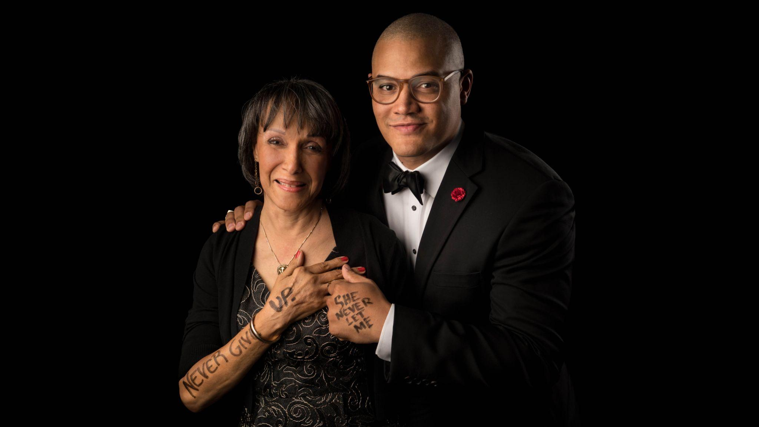

Slide 8
2025: future goals, aims & ideas
Notes:
Sonny takes over.
Shares his vision for SOAS future.-continue steady growth, as we think of 200 boys what funding looks like to keep them in for 8-10 years. And setting ourselves up for strategic growth. Sharing best practices with similar organizations. And goals for recruiting more mentors and achieving more pairings. Goal of 73% of our boys one-on-one paired by end of year.
“We can’t get to 2023 without starting when I was 3 years old.”

Slide 9
Who we
serve
500
YOUTH
MENTEES
ALUMNI SCHOLARSHIP SUPPORT

Slide 10
40

Slide 11
Notes:
Citation info:
1 “Father Absence and Youth Incarceration,” Journal of Research on Adolescence, Harper & McLanahan, 2004
2 “What Can the Federal Government Do To Decrease Crime and Revitalize Communities?” Panel Papers, US Department of Justice, 1998
3 “Father Absence, Father Deficit, Father Hunger,” Psychology Today, Kruk, 2012
4 United States Census Bureau, 2017

Slide 12
Our Logic Model
Notes:
Elliot discusses

Slide 14
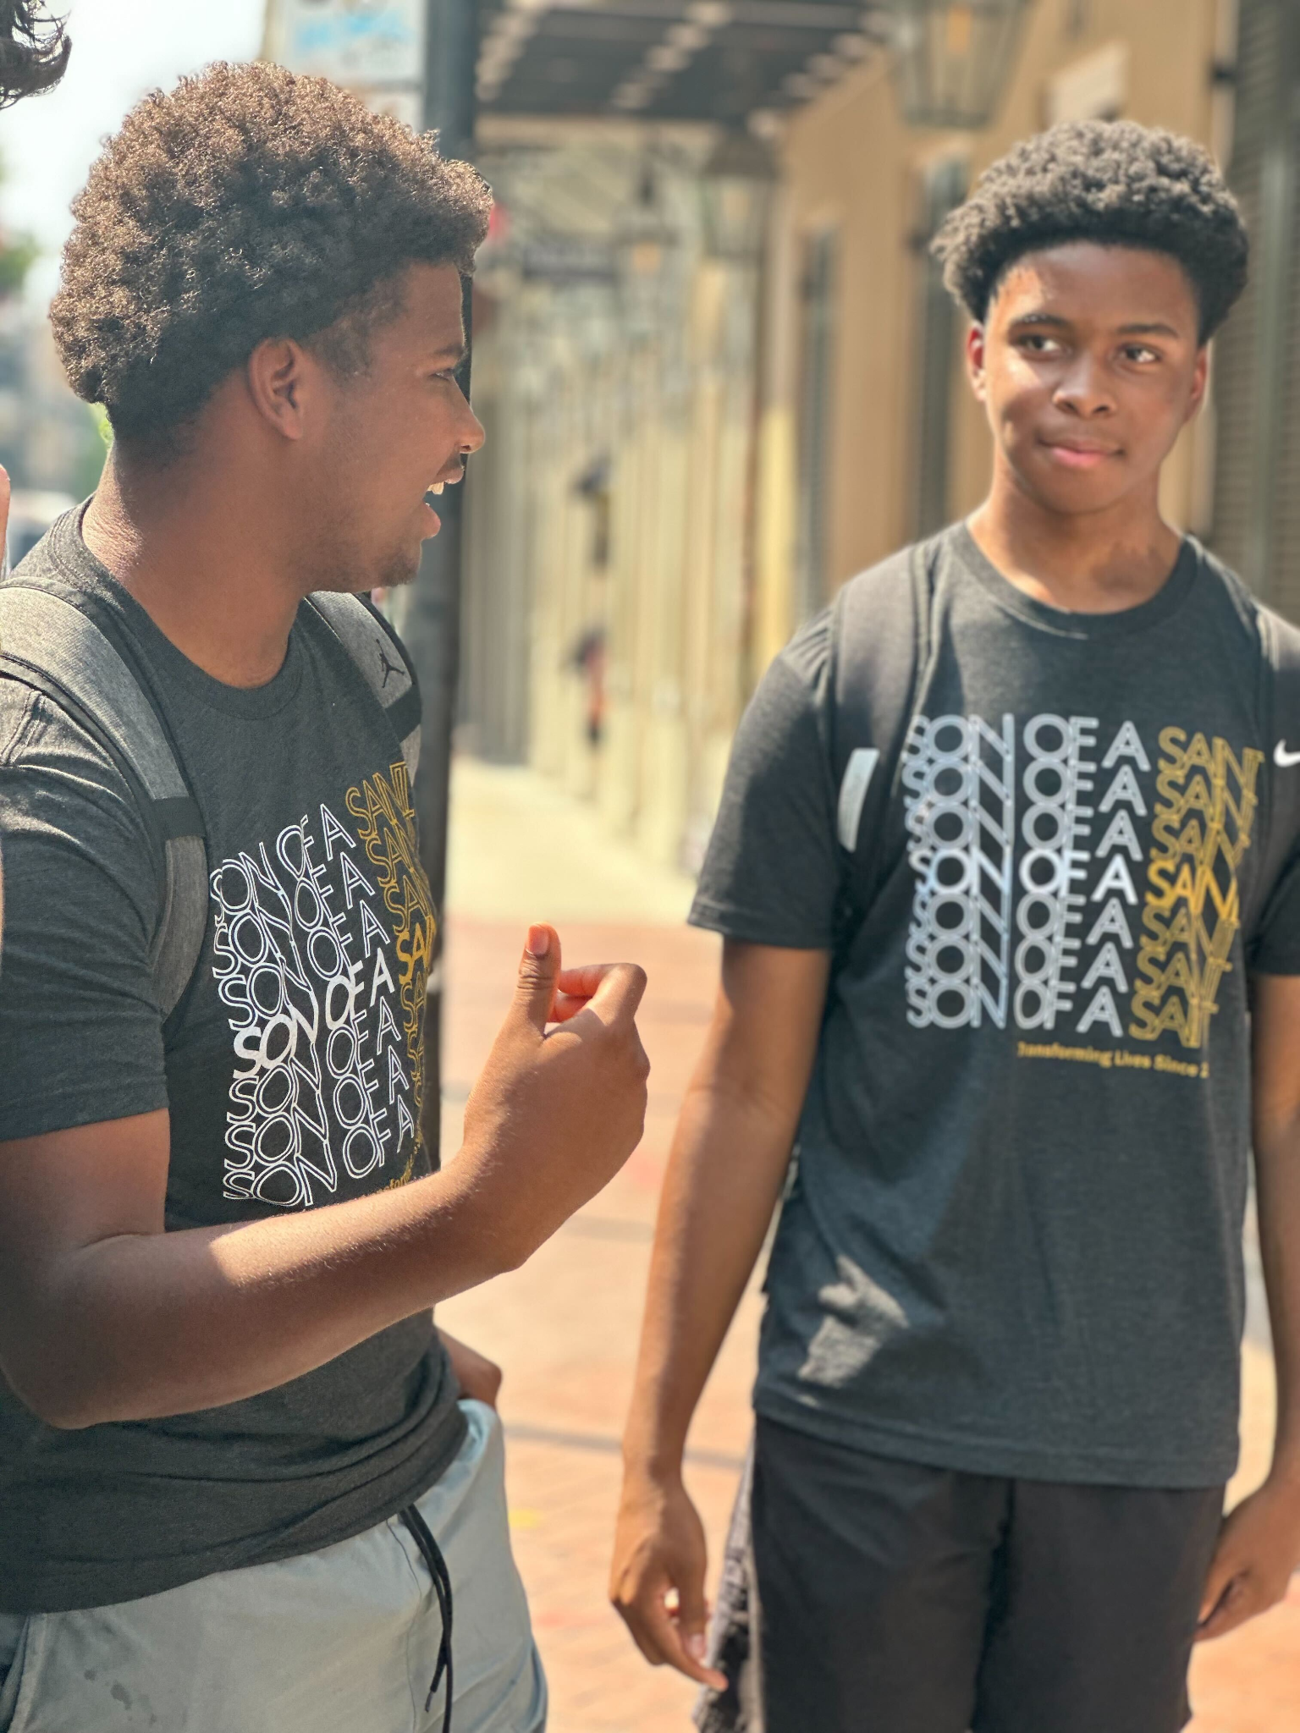
2023 to NOW
More mentees. More mentors. More services. More growth.

Slide 15
Origin and Growth
Notes:
Elliot discusses

Slide 16
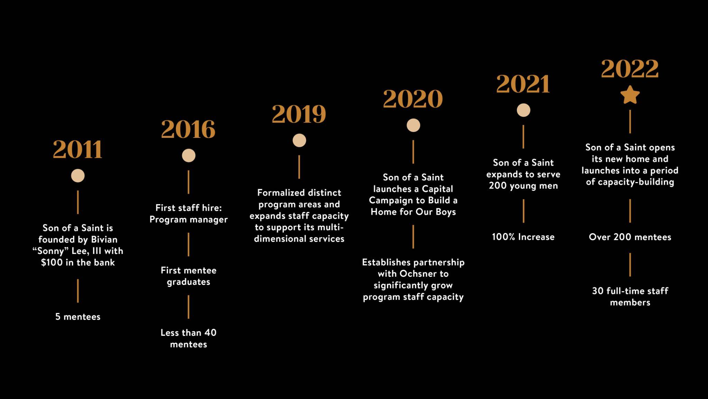
Notes:
Elliot speaks. Introduces Sonny afterwards. Lots of convincing
2016 first year we graduated first mentee. Alejandro speak to Why we accept boys between 10-12 (not rigid. Have ability to meet people where we are. Have an 8year old)
$1.2 million one time investment to anchor the capital campaign from oschner.

Slide 18
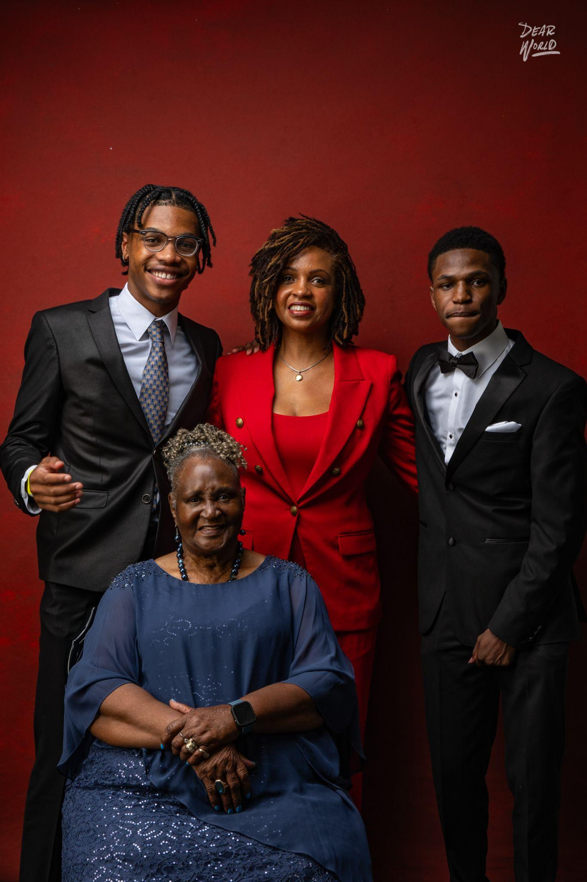

Slide 19
Notes:
Sonny discusses our success data
Citation info:
aUnited Health Foundation (2021). bPerry (2016). cNational Center for Education Statistics (2020). dLouisiana Department of Education (2020). eThe ACT (2019). fLouisiana Department of Education (2020). gNational Center for Education Statistics (2019). hLouisiana Department of Education (2020). iU.S. Bureau of Labor Statistics (2020). jLouisiana Department of Education (2020). kThe Annie E. Casey Foundation (2020). lThe Cowen Institute (2012).

Slide 20
IF YOU LOVE NEW ORLEANS, INVEST IN ITS FUTURE.
Notes:
Elliot speaks

Slide 21
Email: Sonny@sonofasaint.org
Thank you.
Notes:
Elliot speaks

