Slide 1

WHAT, In This Economy?
Peter RICCHIUTI

Slide 2
DISCLAIMER
THE MATERIAL COVERED IN THIS PRESENTATION IS THE OPINION OF THE PRESENTER AND SHOULD NOT BE CONSTRUED AS A RECOMMENDATION TO BUY OR SELL ANY OF THE SECURITIES MENTIONED. INVESTORS SHOULD SEEK THE COUNSEL OF THEIR FINANCIAL ADVISOR BEFORE MAKING ANY KIND OF INVESTMENT. THE PRESENTER MAY OR MAY NOT HOLD LONG OR SHORT POSITIONS IN ANY OF THE SECURITIES MENTIONED.

Slide 3
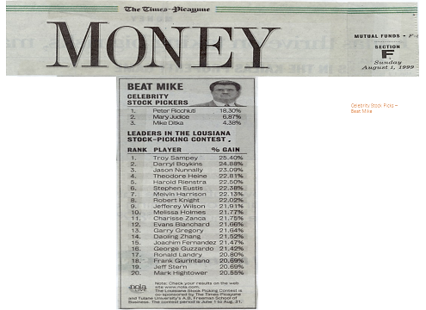

Slide 4
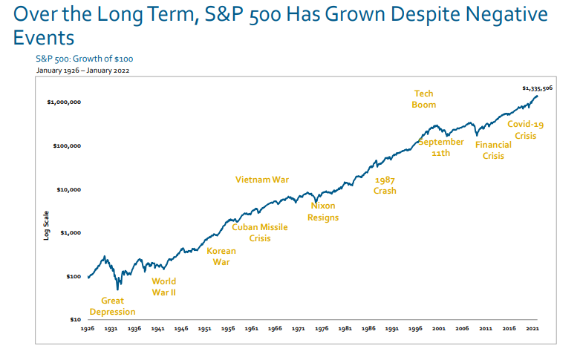

Slide 5
THE STOCK MARKET
The Stock Market Is NOT The Economy.
The Stock Market IS A Measure Of Future Corporate Profits.

Slide 6


Slide 7
WALL STREET SAYS
A little bit bumpy
SHORT TERM
Regulation
Weak housing starts
Labor

Slide 8
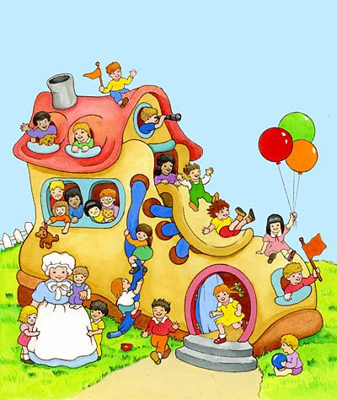
HOUSING TROUBLES
          DEMAND.
-Relatively High Interest Rates
-Higher Insurance Costs
-Buyers Can’t Afford The Monthly Note
          SUPPLY.
-People STUCK In Their Homes
-We’re Short 650,000 Contractors

Slide 9
WALL STREET SAYS
The sky is the limit
LONG TERM
Global warming
Need for better cooling and heating systems in new climate environment
Commercial work appears stronger than residential housing

Slide 10
ONE YEAR RETURNS …
S&P 500 +19%
S&P 500 Equal Weighted +16%
Nasdaq 100 +15%
Russell 2000 + 14%
Dow Jones +12%
                September 2026

Slide 11
NOT REALLY DIVERSIFIED
The S&P 500 has five hundred stocks in it.
However, about 35% of the index is made up of “the magnificent seven”!

Slide 12
WHAT IS THE FEDERAL RESERVE?
Quiz
- 25% A Brand of Whiskey
- 30% An Indian Reservation
- 45% A Wildlife Refuge

Slide 13
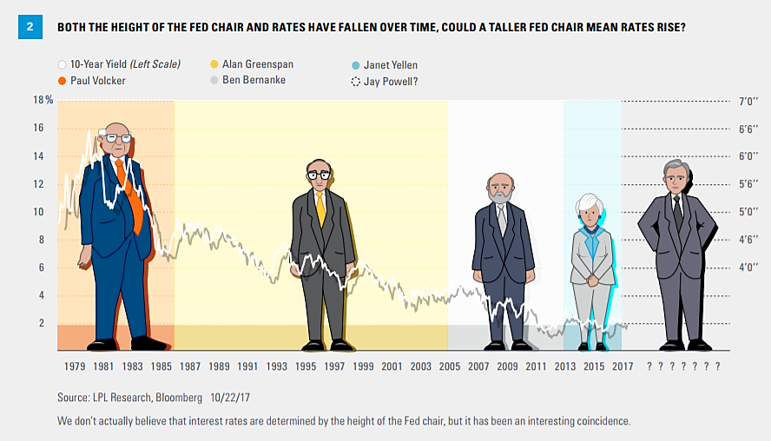
TALLER RATES

Slide 14
THE FED’S DUAL MANDATE
To Keep The Economy Moving Forward
While Holding Down The Rate Of Inflation.
IT’S NOT EASY

Slide 15

STAGFLATION
Persistent high inflation combined with high unemployment and stagnant demand in a country’s economy

Slide 16

PROFITS COUNT, A LOT!
  Over The Long Run, Stock
  Prices Move In Line With Corporate Profits
  Source: Standard & Poor’s

Slide 17
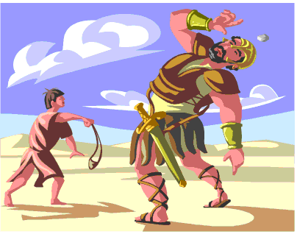
WHY I LIKE SMALL CAPS
Faster growth and higher historical long-term returns
Management often owns a lot of shares
More flexible as economic winds shift
More likely to be bought out.
Generally, more domestically focused
Catalysts can “move the needle” for the company

Slide 18
ANNUAL S&P 500 EARNINGS
2025 - $279
2024 - $247
2023 - $225
2022 - $218
2021 - $209
2020 - $140
2019 - $163
2018 - $162
2017 - $132
2016 - $118
2015 - $118
2014 - $117
2013 - $110
2028E - $445
2027E - $390
2026E - $350

Slide 19
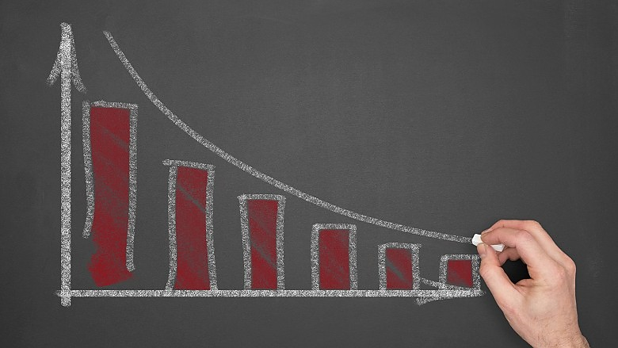

SHRINKING MARKET
In 1995 There Were About 8,000 Public Companies
TODAY THERE ARE ABOUT 3600
Source: www.money.com

Slide 20

SHARE BUYBACKS
Public companies have fallen in love with share buybacks. Over the past 6 years over $1 trillion (each year) have been bought back by their respective public companies.
Profits
________________ = Earnings Per
Shares Outstanding Share (EPS)

Slide 21
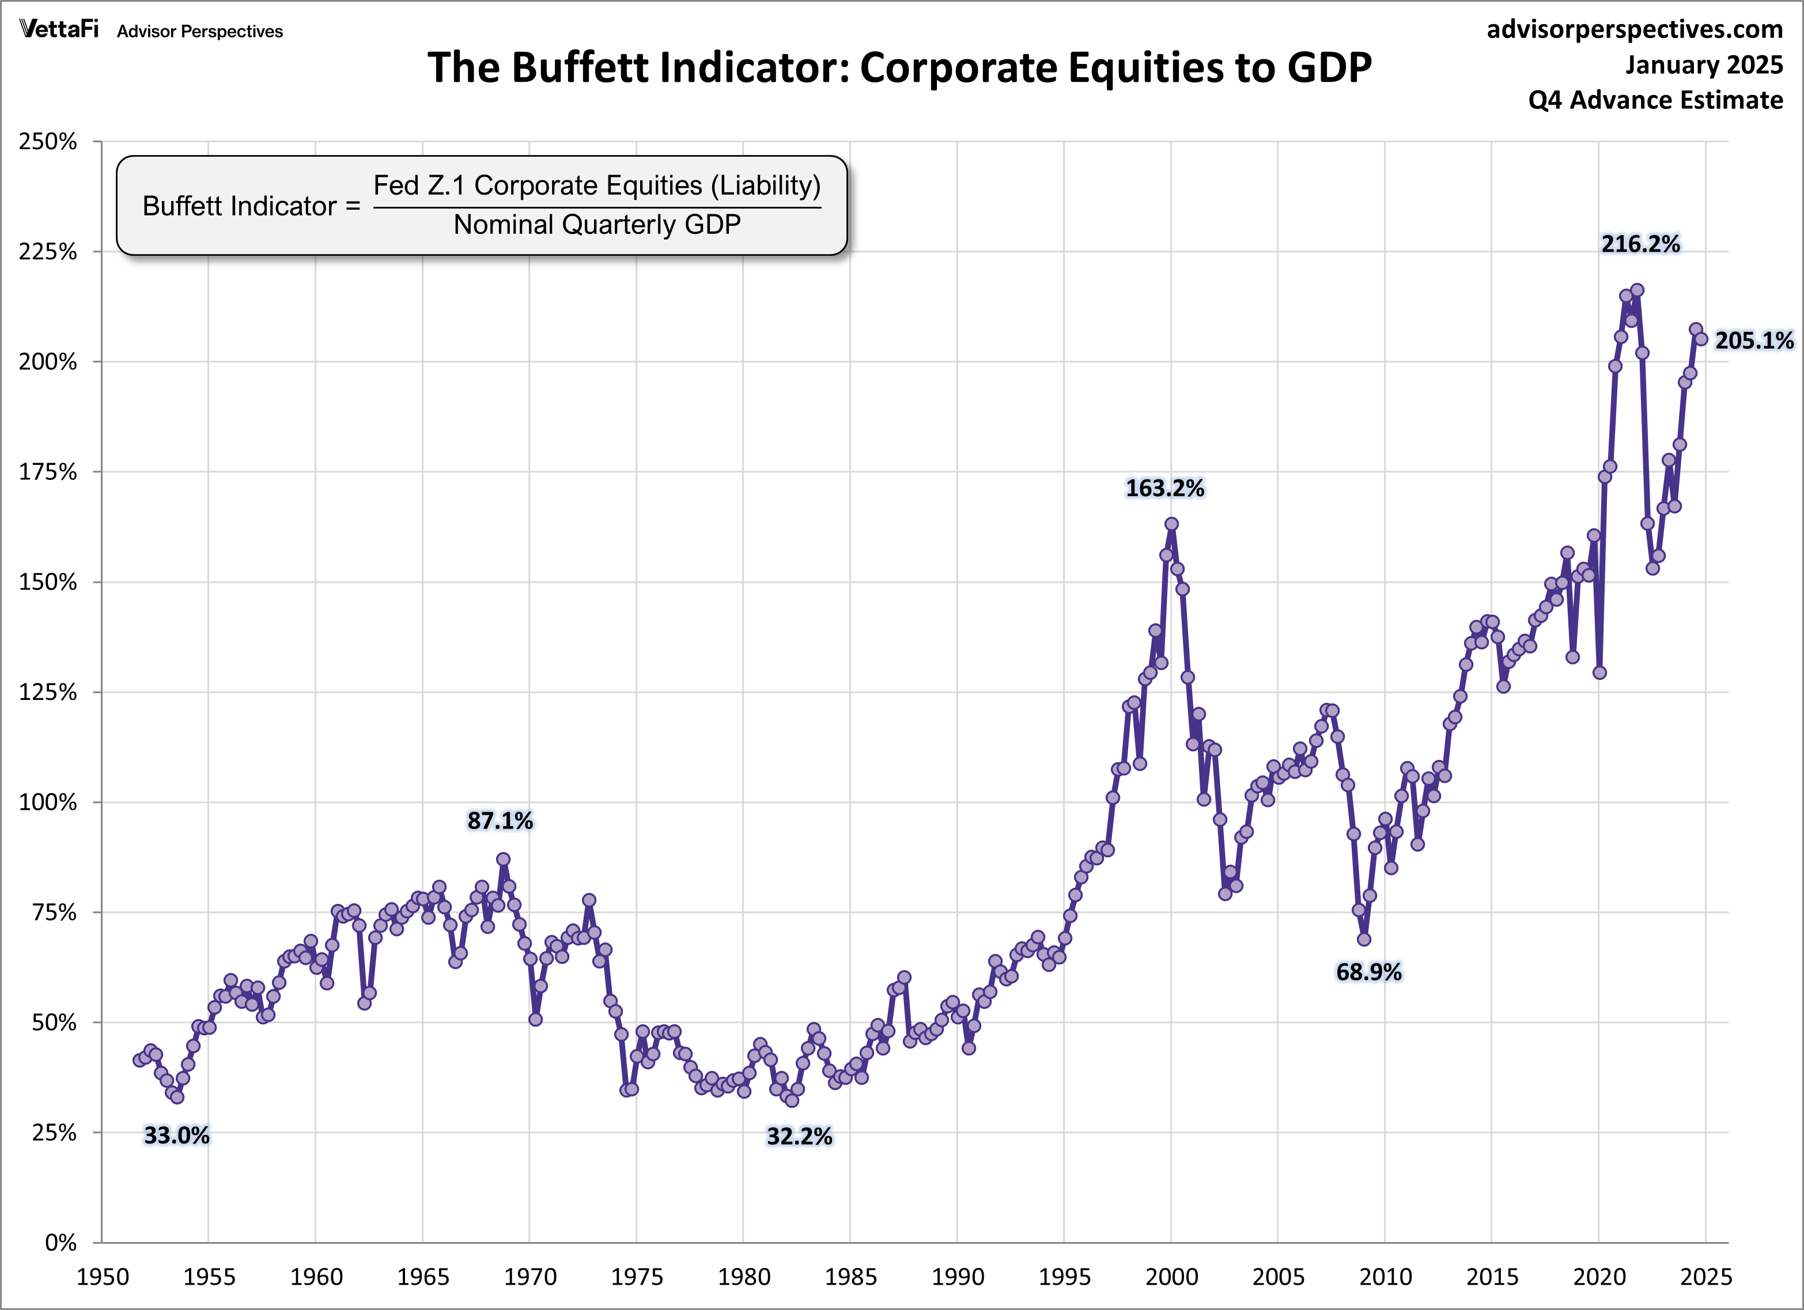
WARREN
BUFFETT INDICATOR

Slide 22
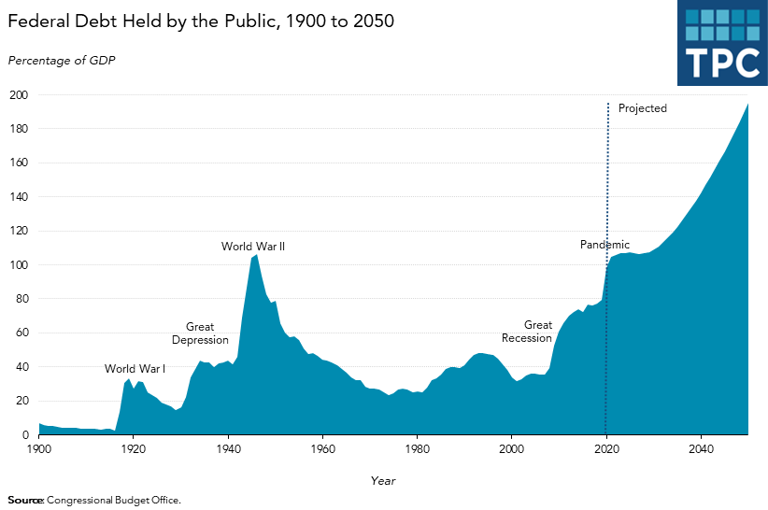

Slide 23

MYTH BUSTER
Never Buy Stocks When The Economy Is Down.

Slide 24
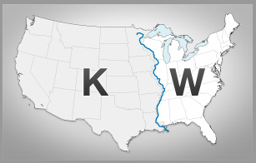
TV & RADIO

Slide 25
EXPECTATIONS
Stock prices rise when a company performs better than investors had expected.
You Pay A High Price For A
  Cheery Consensus
  -Warren Buffett

Slide 26
BIG, But, BEAUTIFUL???
Adds $3.4 Trillion To The National Debt Over The Next Over The Next 10 Years

Slide 27
THE NEXT FINANCIAL DISASTER?
Uninsured Homes,About 2 Trillion in Value
7.5% of Homes Uninsured
It’s Even Higher For:
  Manufactured Housing, and Inherited Homes

Slide 28
AND MORE …
Climate change
Cost of insurance
Can’t find insurance
Severity of storms makes cities like Houston and Miami especially vulnerable

Slide 29
ASSETS/ESG
Pre-1946 | 11.9%
Boomers | 51.8%
Gen X | 29.5%
Millennials | 9.4%
Gen Z | ???

Slide 30

FUEL GAUGE

Slide 31
U.S. LEADERSHIP
The U.S. is becoming a science-led economic juggernaut.
Energy, Technology, Life Sciences.
Although SOMEHOW science skeptics get all the attention; climate change, vaccinations, ….even the group that thinks we staged the moon landing.

Slide 32
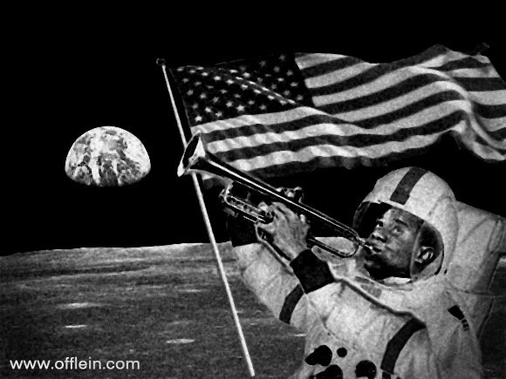
THEN AGAIN, …

Slide 33
THE FED MODEL
$390.00
Forward Earnings for the S&P 500
--------------------------------------------- =
Price of the S&P 500
7,711
According to this measure, with the 10-year Treasury yielding
about 4.8% and stocks have an earnings yield of ~5.1%
On a risk/return basis, stocks appear a bit more attractive than
bonds are equally attractive
November2025

Slide 34
PANDEMIC EFFECTS
Simpler Supply Chains
On-Shoring (US, CA and MX)
-BUT, not necessarily more jobs
Higher Inventory Levels
Costs AND RESILIENCE
Succession Plans

Slide 35
BORDERLINE CRAZY
“The Whole Concept Of The Balance Of Trade Is Absurd”
-Adam Smith, The Father Of Economics

Slide 36
TARIFFS
“Tariffs Are Prosperity Killers.”
-Larry Kudlow, President Trump’s Economic Advisor
“The Tariffs are Insane”-
-Alan Greenspan, Former Fed Chief

Slide 37
WHO PAYS?
Tariffs are paid for by the American consumer.

Slide 38
DEMOGRAPHICS
Without immigration the U.S. population of working age people shrinks.
(See Japan, Italy, etc.)

Slide 39

UNDER-INVESTED
The Average U.S. Investor has about 80% of Their Portfolio in Domestic stocks.
U. S. Stocks Represent
Less Than Half of the
World Market.

Slide 40
MISINFORMATION
TV News
Internet
Print
The best way to build an audience is to skew stories that make people angry and fearful.
I
i

Slide 41
POLITICS
Don’t Let Personal Politics Influence Your Investment Decisions.

Slide 42
LAST 50 YEAR RETURNS
(S&P 500)
        Bill Clinton +15.2%
        Donald Trump +14.1%
        Barack Obama +13.8%
        Joe Biden +11.1%
        George H.W. Bush +10.9%
        Ronald Reagan +10.2%
        Jimmy Carter + 6.3%
        George W. Bush - 6.2%

Slide 43

OUR ECONOMY
70% Consumer Driven
Middle class consumers are the job creators.

Slide 44
DEMOGRAPHICS
Without immigration the U.S. population of working age people shrinks.
(See Japan, Italy, etc.)

Slide 45
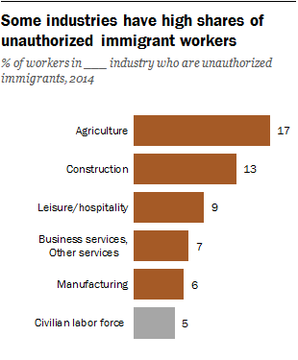

Slide 46

LABOR SHORTAGES
Workers at Nursing Homes and Retirement Centers
OH, NO.

Slide 47

THE KIDS ARE ALRIGHT
This generation is smarter
and more community minded.
More mobile, more urban and
starting families later.
Source: BARRONS

Slide 48
UNIVERSITIES
U.S universities are #1, the envy of THE WORLD.
Magnets for the the best and the brightest.
The edge the U.S. needs to stay competitive.
Creating advancements in science, advanced manufacturing, medicine and business.

Slide 49
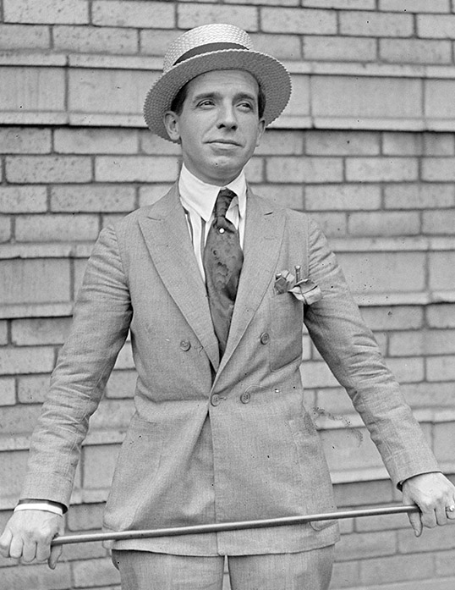
PONZI SCHEMES
Social Security And Medicare Require More (Young) People Entering The Plan.

Slide 50
DANTE’S INFERNO
The Hottest Places In Hell Are Reserved For Those, Who In Times Of Great Moral Crisis, Preserve Their Neutrality.

Slide 51
RECESSIONS
November 1973 16 months
January 1980 6 months
July 1981 16 months
July 1990 8 months
March 2001 8 months
December 2007 18 months
March 2020 2 months

Slide 52
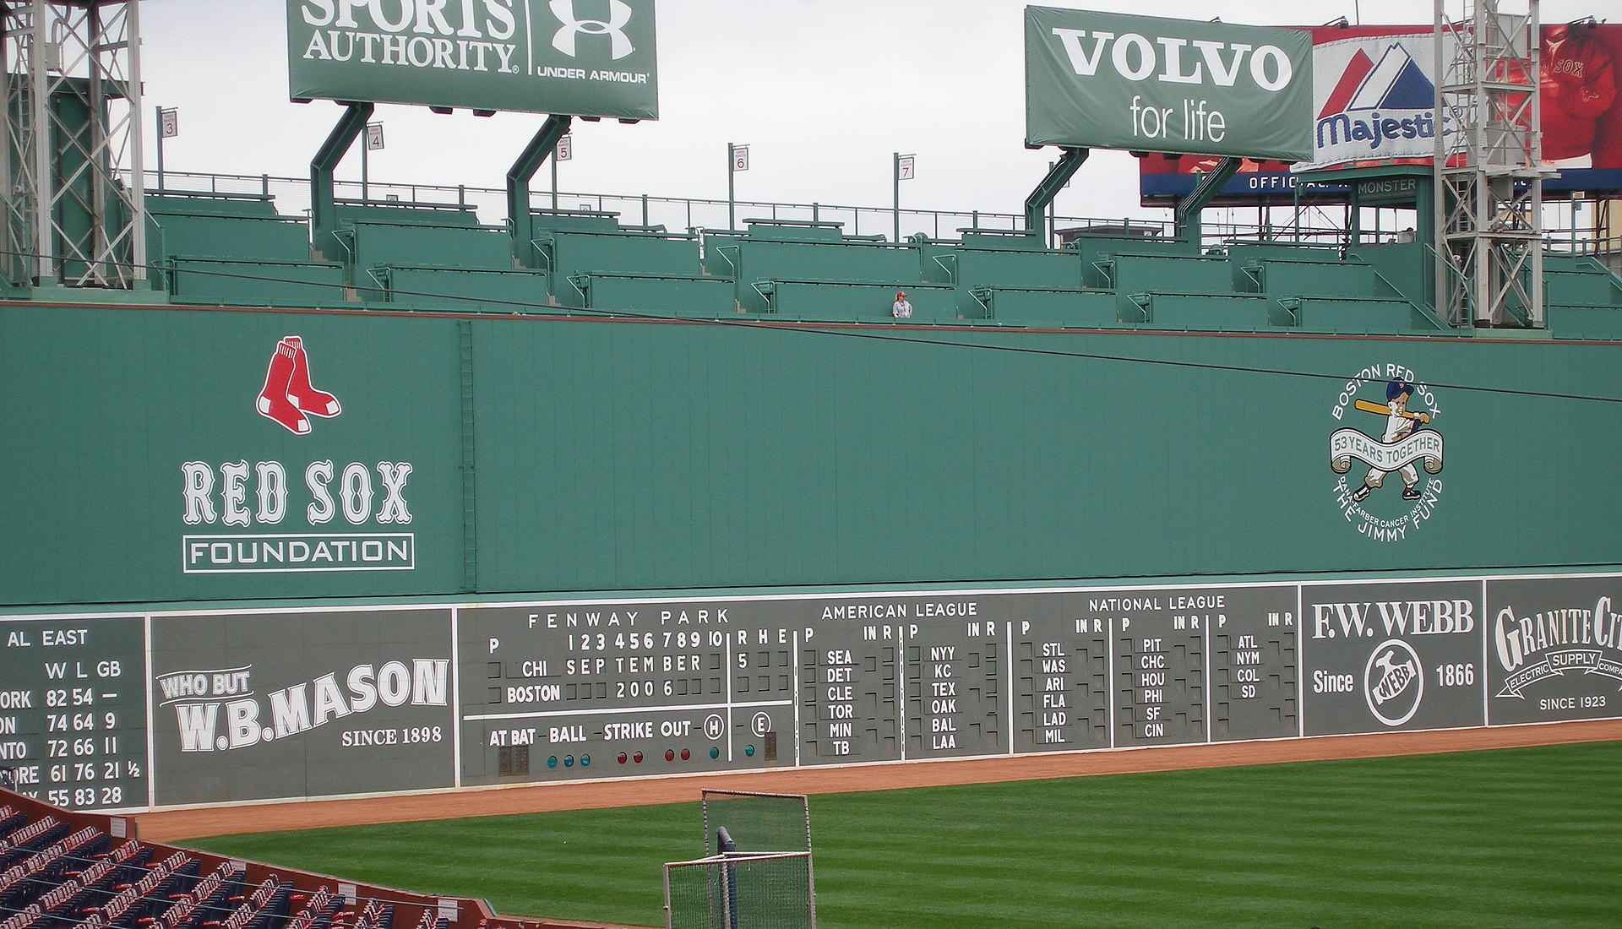
WHICH INNING?
        Average expansion, 5-7 years
    Average recession,1 year

Slide 53
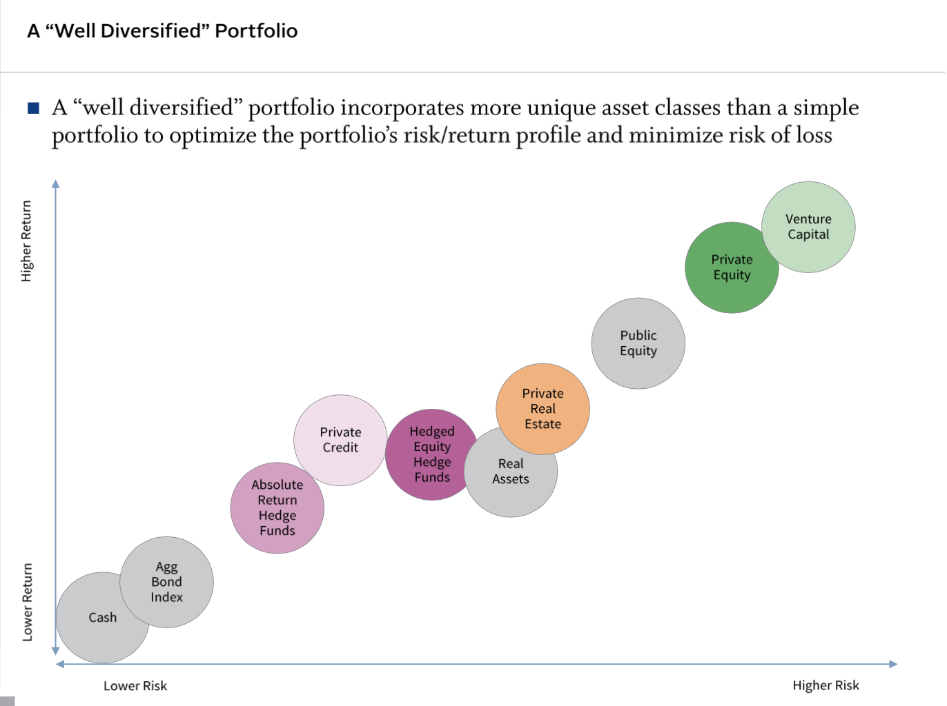

Slide 54
INVESTING FOCUS
Infrastructure
-Rebuilding Electric Grid
Aging Population
Applied Technology

Slide 55

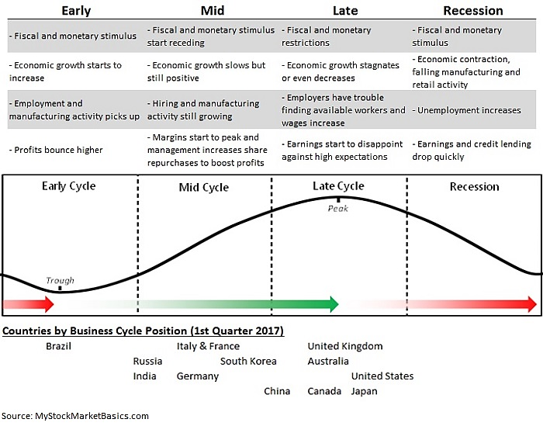
BUSINESS CYCLES
Fiscal and Monetary Restrictions
Employers Have Trouble Finding Available Workers and Wages Increase
Fiscal and Monetary Stimulus
Economic Growth Starts To Increase
Margins Start to Peak and Management Begins to
Increase
Share
Repurchases To
Boost Profits
Economic Contraction, Falling Manufacturer and Retail Activity
Earnings and Credit Lending Drop Quickly

Slide 56

SAVING CAPITALISM
At the time of the French Revolution (1789) the top 3% of French “Elites” commanded 30% of the country’s wealth.
Today, the top 3% in the U.S. own 52 % of the nation’s wealth.

Slide 57
LEAST EXPENSIVE COST OF LIVING
Arkansas
Louisiana
Mississippi

Slide 58

K SHAPED RECOVERY ???
Upper class
Middle/lower class

Slide 59
IMPORTANT MATH
If The market (or an individual stock) falls 50%. You’ll need a 100% increase to get back where you started.

Slide 60
NEW AND IMPROVED
  Things are getting better for most of us.
  The babies born in America today are the luckiest crop in history (Warren Buffett)
  The average American today enjoys access to better transportation, entertainment, communications and medical services than the robber barons did in the 1930’s.

Slide 61
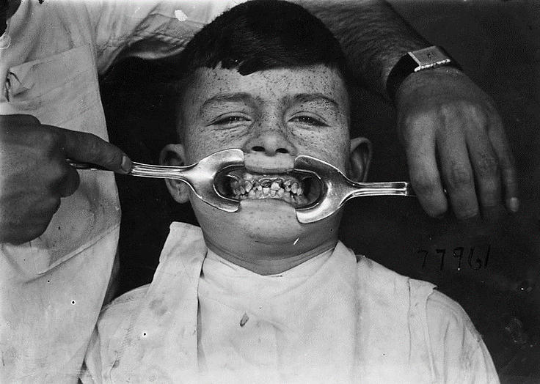
THINK DENTISTRY

Slide 62

HIGH SCHOOL
Financial literacy
Critical thinking
Statistics

Slide 63
FOMO?
CBD?
Bitcoin?
NFT?
AI?

Slide 64
SHRINKAGE
1990:
7,000 Publicly Traded Companies
2026: 4,000 Publicly Traded Companies

Slide 65
FURTHERMORE …
Since 2020 U.S. public companies have bought back more than $1 trillion of stock each year.
Profits = Earnings
Shares Outstanding Per Share

Slide 66
STOCKS ARE REAL ASSETS
    THE ELECTED BOARD OF DIRECTORS DECIDE:
    -pay down debt
-declare dividends
-buy back stock
-pursue M&A opportunities

Slide 67
A.I.
Pretty Proficient?
Use It As If It Were Google?

Slide 68
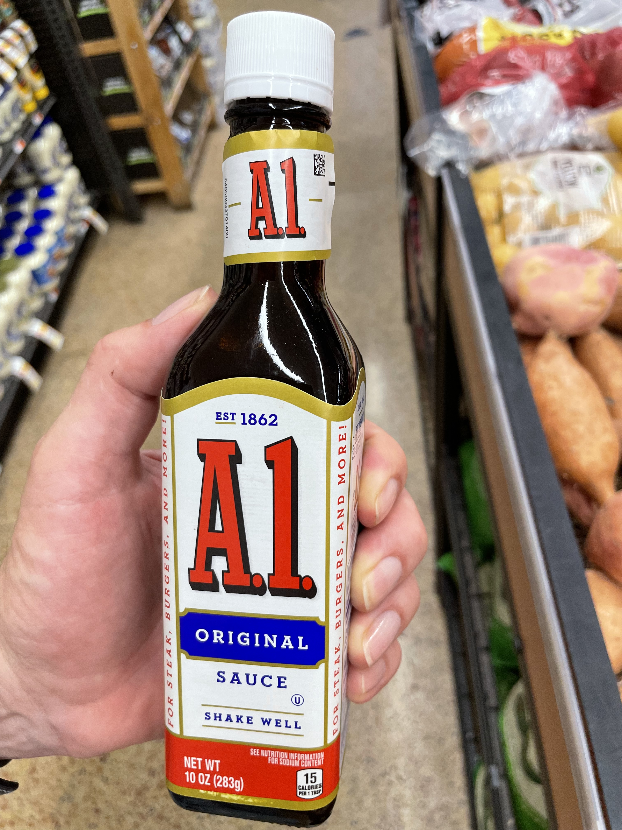

Slide 69
IT’S ALL ABOUT A.I.
The Financial Markets.
OVERWEIGHTED. About +30% of the S&P 500 is weighted by 7 tech companies
Nearly every public company will be able to increase its profits by using A.I..

Slide 70
A.I.’S IMPACT ON GDP
The U.S. economy is currently growing at 2.1%
A.I. accounts for .50%
So, without A.I. the U.S. economy is growing at only about 1.6%

Slide 71
A.I. JOBS
There will be millions of jobs lost, …
But, Historically Technology Has Created More Jobs Than It Has Eliminated

Slide 72
BENEFICIARIES OF PRODUCTIVITY
Companies-Higher Profits (EPS)?
Employees-Higher Pay?
Customers-Lower Prices?

Slide 73
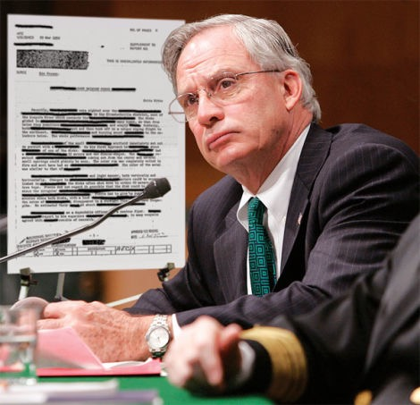
BLACK HIGHLIGHTERS
The Onion

Slide 74
HERE, IN LOUISIANA
2024 (U.S. Census)
Louisiana’s Total Population rose a bit but,
43 Of 64 Parishes Lost Population.

Slide 75
MANUFACTURING MYTH
“ We don’t manufacture much in this country.”
The U.S. has been manufacturing at its highest level ever, but with far fewer workers
About 90% of job losses in manufacturing are due to efficiencies automation/robotics.*
*Ball State University

Slide 76
U.S. LEADERSHIP
The U.S. is becoming a science-led economic juggernaut.
Energy, Technology, Life Sciences.
Although SOMEHOW science skeptics get all the attention; climate change, vaccinations, ….even the group that thinks we staged the moon landing.

Slide 77
THEN AGAIN, …

Slide 78

ENERGY THOUGHTS
Oil Demand Issues
- Alternative fuels
Fuel efficiency
- Ride-sharing
Electric cars
(70% of oil is used for transportation).

Slide 79
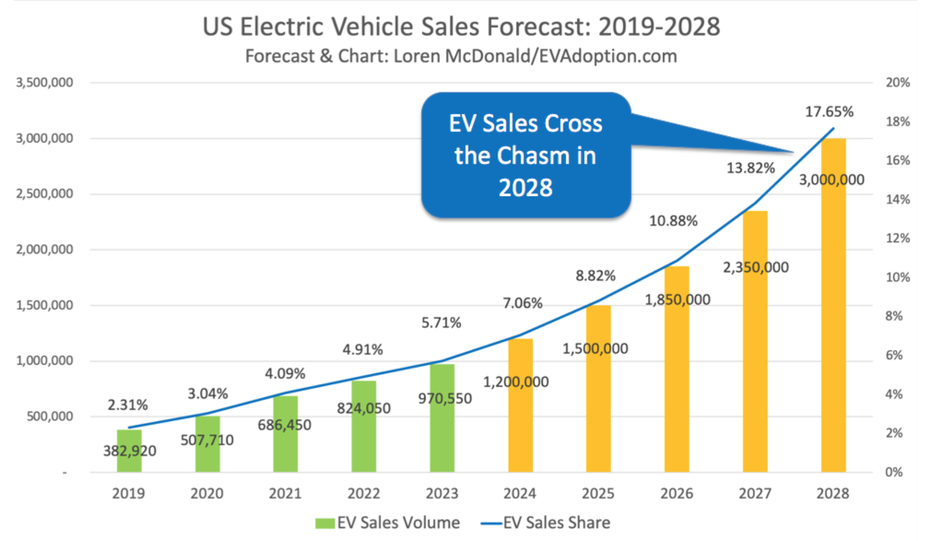
ELECTRIC AVENUE

Slide 80
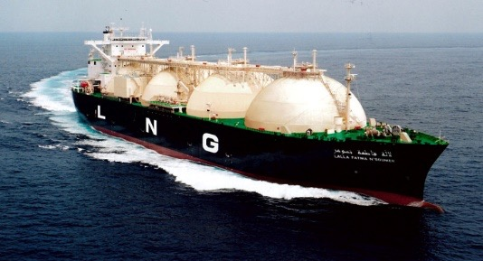
LNG
LNG is clearly the “game-changing” part of energy both today and tomorrow.

Slide 81
PEAK OIL DEMAND
A Big Difference Of Opinion
International Energy Agency Says It’s In 2030.
Exxon and Aramco Believes It’s About 2058.

Slide 82

DISTINCTIONS
Electricity is generated by; natural gas, coal, solar, wind, …
BUT, planes, trains, (and boats), and automobiles are nearly entirely
fueled by oil.
Oil doesn’t create electricity.

Slide 83

ECONOMIC IMPACT
□ Lower prices at the pump save consumers billions of dollars.
□ This is good news for retailers, U.S. manufacturers and other businesses
such as the airlines.
□ U.S. Foes “de-fanged”.
Source/Photo: Bloomberg

Slide 84
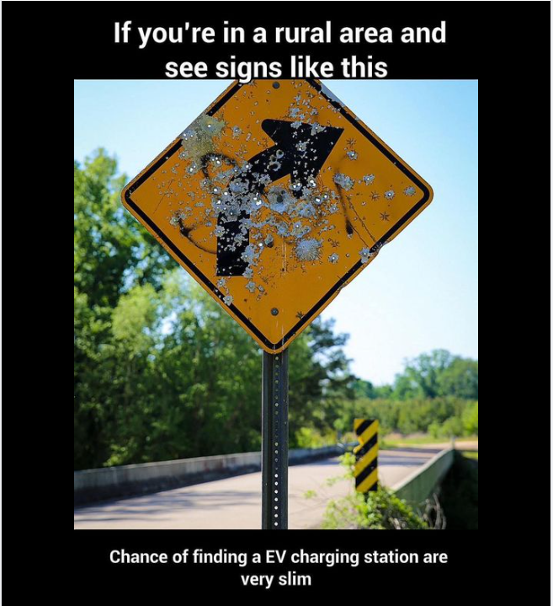

Slide 85
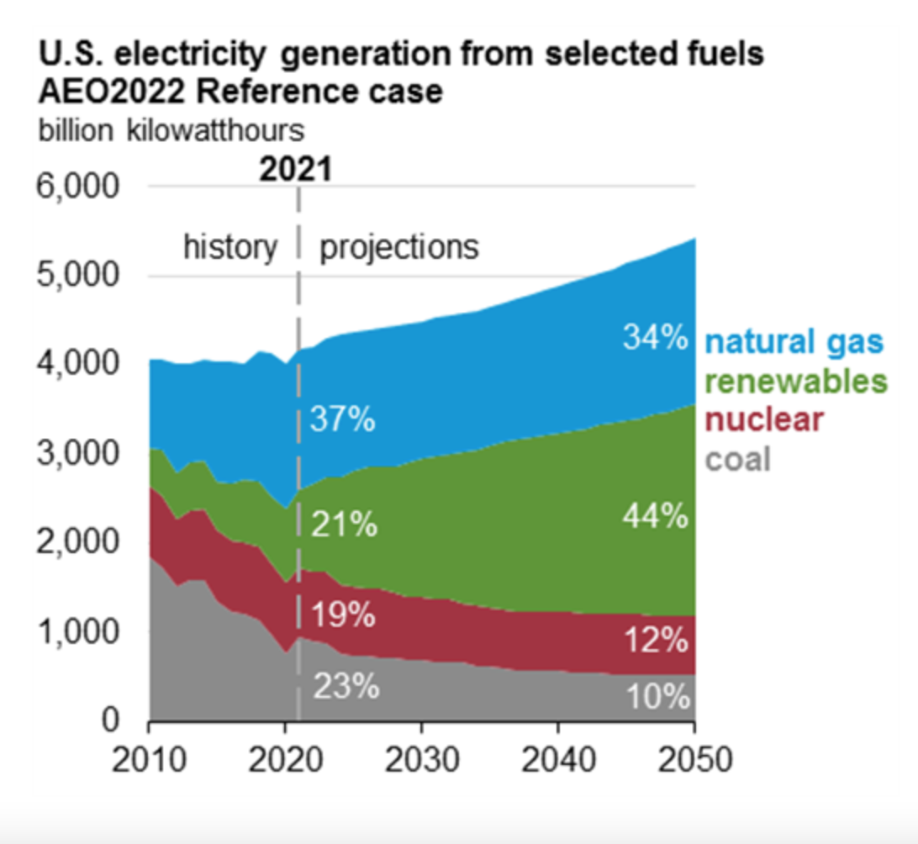
FUTURE FUEL

Slide 86
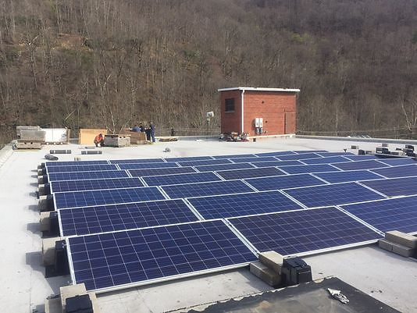
COAL MUSEUM
Source: The Louisville Courier, April 2017

Slide 87

THE REAL ME MEMHE REAL ME

Slide 88
GREAT READING & SOURCES
Popular Books
How To Invest, David Rubenstein (Simon & Schuster)
One Up On Wall Street, Peter Lynch (Simon & Schuster)
A Zebra in Lion Country, Ralph Wanger (Simon & Schuster)
The Money Masters, John Train (Harper & Row)
The Little Book That Beats The Market, Joel Greenblatt (Wiley & Sons)
Analytical Books
The Intelligent Investor, Benjamin Graham (Harper & Row)
Security Analysis, Benjamin Graham (McGraw-Hill)
Personal Favorite Sources
BARRONS, Bloomberg, The Economist, Axios, Last Bastion (lastbastion.com)
Howard Marks’ Memos (www.oaktreecapital.com)

Slide 89
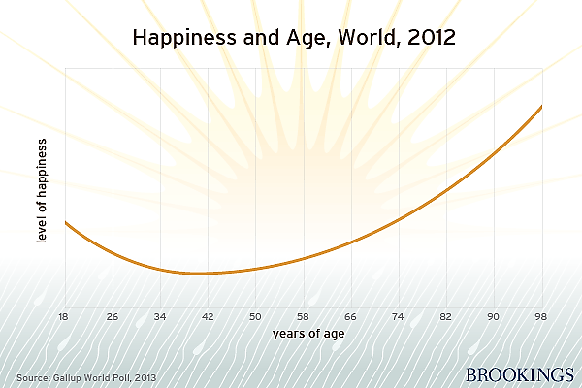
HAPPINESS AND AGE
Older people are happier and feel healthier when they are active and feel needed.
A happy work-free retirement is a myth.
*The Brookings Institute

Slide 90
THINK ABOUT IT
“As long as people have babies, capital depreciates, technology evolves and tastes and preferences change, there is a powerful underlying impetus for growth that is almost certain to reveal itself in any reasonably well-managed economy”
-TIM DUY
Democracy And Capitalism Are The Only Systems That Work.

Slide 91


BURKENROAD.ORG

